Slide 1
Survey Analysis Project
By
Arnav Ashank

Slide 2
Course vs Country

Slide 3
Inference from pie-chart
In the slide above we see that how the enrollments in four major courses(in terms of total enrollments of students) at Udacity is distributed over the countries.
From the pie chart it is clear that Canada has got the least participation in these courses.
Also it is evident from the charts that developing countries(India, China, Japan, Mexico etc.) form the majority of enrollments which depicts the awareness in these fields among developing countries.
There is a significant variation in the enrollments from countries like UK, Argentina in the four major courses.

Slide 4
Commute time vs Job Level
Bar graph alongside depicts the variation in commute time with Job-Level.
It’s clearly evident that the commute time for an Individual contributor outweighs the commute time for people at other levels.
Also the top management(President, Vice-President, Director) have much less commute time.
Time in minutes
Manager level employees also have high commute time as compared to C-level and higher level employees.

Slide 5
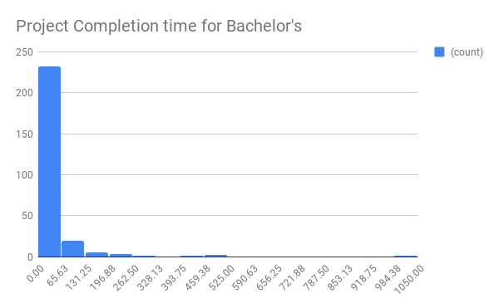
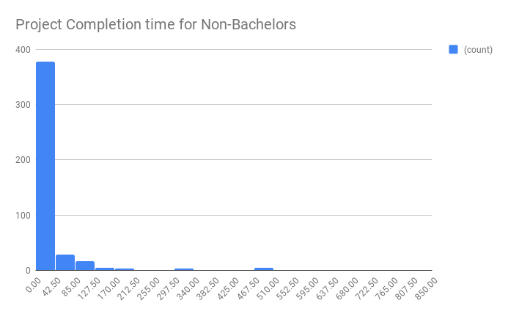
Project Completion time by Education
Time in hours
Time in hours
Here are histograms for Bachelor’s versus Non-Bachelor’s.
Both distributions are right-skewed therefore mean for each is higher than the median.
There is quite little variation in mean between the two groups approximately 35 for Bachelor’s and 32 for Non-Bachelor’s.
The standard deviation for Bachelor’s is 82 hours approximately and for non-bachelor’s it is 74 hours. Thus variability in project completion time for bachelor’s is more than that for non-bachelor’s. This may be due to presence of outliers with time more that 500 hours which otherwise removed the standard deviations of two graphs would be same.

Slide 6
Motives of students Enrolled in Udacity Courses
The chart alongside depicts the motives with people enrolled themselves in the various courses at Udacity.
The count of starting a new career shows that majority of courses are of beginner level at Udacity.
The counts of preparing for an advanced degree and for the growth of skills at work show that courses at Udacity for advanced level are considerably less as compared to beginner level courses.

